Slide 1
Proton Plan
Eric Prebys, FNAL Accelerator Division

Slide 2
Acknowledgements
Proton Plan Team
  Jeff Spalding
  Bruce Baller
Significant contributors (in no particular order)
  Alberto Marchionni (MI)
  Ioannis Kourbanis (MI)
  Kiyomi Koba (MI)
  Bill Pellico (PS)
  Jim Lackey (PS)
  Larry Allen (PS)
  Elliott McCrory (PS)
  John Reid (RF)
  Dave Harding (TD)
  Dan Wolf (EE)
  Weiren Chou (Integration)
  Peter Garbincius (Management)
  Dave McGinnis (Management)
  + others

Slide 3
Charge
Develop a plan for a reasonable set of improvements and operational initiatives to maximize proton delivery to NuMI and the Booster Neutrino Beam (BNB) over the next ten years or so.
Estimate the budget and timeline for these improvements.
Estimate proton delivery to both beam lines if the Plan proceeds on schedule.
Note: this plan is exclusive of the Proton Driver, which we assume will one day replace the existing Proton Source (Linac+Booster).

Slide 4
From the Executive Summary
We present a three-year plan for increasing the proton intensity delivered to the two currently approved neutrino experiments, with upgrades to the Linac, Booster and Main Injector. When the elements of this plan are completed, NuMI will accumulate approximately 3.4E20 protons per year. BNB will receive approximately 2.2E20 protons per year, however the latter estimate is highly dependent on the performance of the Booster and other efficiency factors.
The preliminary estimate for the total cost of this plan, including 46% contingency, is $34M ($23M M&S, $10M labor SWF). The labor cost estimate includes technical, physicist and project management effort. Overhead is not included in these estimates.

Slide 5
Strategy
Increasing the proton delivery from the Booster to NuMI and MiniBooNE
  Increase maximum average Booster repetition rate
  by increasing acceptance, and by improving orbit control (less loss for more beam).
Increasing the beam intensity in the Main Injector for NuMI
  Main Injector multi-batch operation
  Slip stacking in Main Injector (requires RF upgrade)
Improving operational reliability and radiation limitations
  Linac quad supplies
  Booster and Linac Instrumentation
  Booster RF Upgrade
  Investigate 7835 Problem

Slide 6
Breakdown of Plan
WBS | Description | M&S Base | M&S Cont | M&S Total | SWF Base | SWF Cont | SWF Total
1 | Proton Plan | 16,513 | 42% | 23,486 | 6,648 | 57% | 10,419
1.1 | Linac Upgrades | 2,705 | 86% | 5,039 | 981 | 65% | 1,622
1.1.1 | Linac PA Vulnerability | 2,000 | 100% | 4,000 | 300 | 100% | 600
1.1.2 | Linac Quad Power Supplies | 617 | 50% | 925 | 628 | 50% | 942
1.1.3 | Linac Instrumentation Upgrade | 88 | 30% | 114 | 53 | 50% | 80
1.2 | Booster Upgrades | 6,499 | 35% | 8,765 | 2,777 | 54% | 4,262
1.2.1 | Determine Rep Rate Limit | 0 | 0 | 0 | 110 | 50% | 165
1.2.2 | ORBUMP System | 256 | 42% | 364 | 231 | 47% | 338
1.2.3 | Corrector System | 629 | 58% | 995 | 715 | 57% | 1,124
1.2.4 | 30 Hz Harmonic | 1,031 | 35% | 1,388 | 279 | 60% | 447
1.2.5 | Gamma-t System | 0 | 0 | 0 | 50 | 100% | 100
1.2.6 | Alignment Improvements | 0 | 0 | 0 | 60 | 50% | 90
1.2.7 | Drift Tube Cooling | 10 | 50% | 15 | 10 | 50% | 15
1.2.8 | Booster RF Cavity #20 | 300 | 50% | 450 | 120 | 50% | 180
1.2.9 | Booster Solid State RF PA's | 4,200 | 30% | 5,460 | 960 | 50% | 1,440
1.2.10 | Booster Instrumentation | 73 | 27% | 93 | 242 | 50% | 363
1.3 | Main Injector Upgrades | 7,294 | 32% | 9,661 | 2,026 | 60% | 3,239
1.3.1 | Large Aperture Quads | 194 | 50% | 291 | 406 | 50% | 609
1.3.2 | Main Injector Collimator | 200 | 100% | 400 | 150 | 100% | 300
1.3.3 | NUMI Multi-batch Operation | 0 | 0 | 0 | 250 | 100% | 500
1.3.4 | Main Injector RF Upgrade | 6,900 | 30% | 8,970 | 1,220 | 50% | 1,830
1.4 | Management | 15 | 32% | 20 | 864 | 50% | 1,296

Slide 7
Linac Projects
1.1: PA Vulnerability
  Come up with a plan for dealing with the Linac Power Amplifier (7835) situation once and for all. Investigate:
    Low Energy Linac replacement
    Other tubes (e.g. Thales 629)
    Other 200 MHz power (e.g. multi-beam klystrons)
    In-house fabrication
    Significant collaboration with Burle
  Submit report to AD head by Feb, 2004.
1.2: Pulse Quad Power Supplies
  Replace pulsed quadrupoles in the old Linac
  Very similar to pulsed supplies in newer linac
1.3: Instrumentation Upgrade
  Inadequate Linac instrumentation has led to extended periods of non-optimal running
  Only 1/3 of BPM’s instrumented.
  Project started in 2004
  Add 10 MHz digitizers to old linac RF stations
  Move existing BPM digitizers to High Energy Linac
  Instrument all BPM’s with 10 MHz digitizers.

Slide 8
Booster Projects
2.1: Determine the Booster repetition rate limit
  Once the other upgrades described here are complete, the Booster will be capable of extended running at 15Hz, except for the RF system.
  The limit is believed to be 8-9Hz, limited by the main power, but this is not well understood.
  Although the current scope of the plan does not require us to go beyond 9 Hz, we feel it is important to understand the limitation and what would be required to elimiate it.
2.2: ORBUMP System
  Existing injection bump (ORBUMP) has two problems
    Average repetition rate of the magnet and power supply is limited to 7.5 Hz by heating.
    It lacks the power to move the beam out far enough at injection, resulting in a mismatch
  Plan is to replace the (4) magnets and power supply
  Magnet fabrication is under way, with the first magnet just completed.
  Aim to put new system in place during 2005 shutdown.

Slide 9
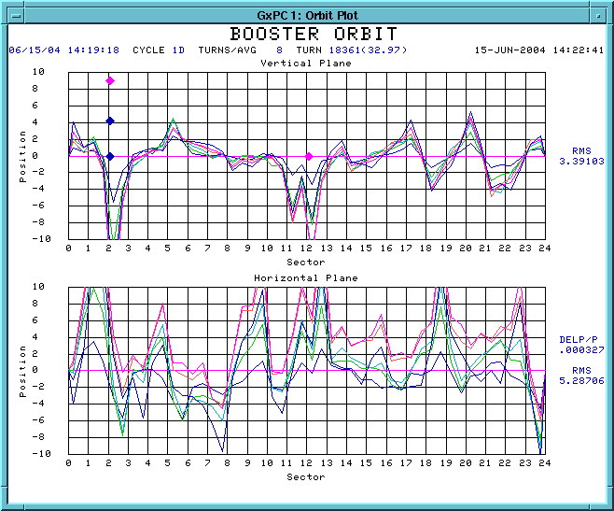
Booster Projects (cont’d)
2.3: Booster corrector system
  Each of the 48 subperiods of the Booster have a trim package which contains H and V dipoles, as well as a quadrupole and a skew quadrupole.
  These are not adequate to control beam position or tune through the cycle.
  There would also be benefits to putting a sextupole in each package.
  We are working with TD to design a new corrector package for the Booster, which will allow precise control of both beam position and tune throughout the cycle.
V
Beam position around ring, relative to injection, at various times in cycle
H

Slide 10
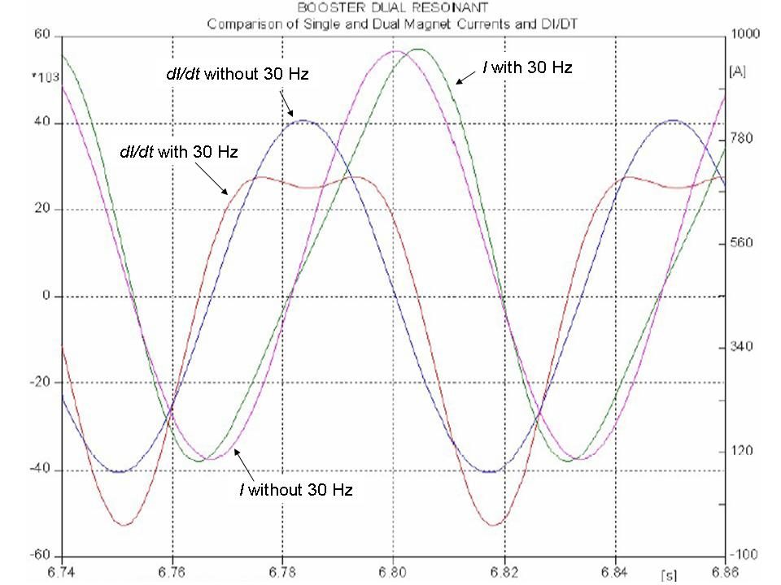
Booster Projects (cont’d)
2.4: 30 Hz harmonic
  The booster lattice magnets operate in a 15 Hz offset resonant circuit.
  By modifying the magnet girdirs to ad a 30 Hz component, we could reduce the maximum acceleration rate, which is equivalent to increasing RF accelerating voltage
  This would allow us to accelerate more beam per batch.

Slide 11
Booster Project (cont’d)
2.6: Gamma-t System
  The booster transition jump system has a long history.
  May be necessary to fully take advantage of other upgrades to increase batch intensity.
  It suffers from misalignment problems and exacerbates coupled bunch instabilities, so we don’t use it.
  Will schedule a series of studies to make a either make it work or decide to abandon it within a year.
2.7: Alignment
  The Booster has never been properly aligned
  Made significant progress in the vertical plane and with RF cavity alignment over the last year.
  Over the shutdown, did a TeV style 3D laser tracker network and as-found.
  Will use this data to form a plan for girder moves over the next year or so.

Slide 12
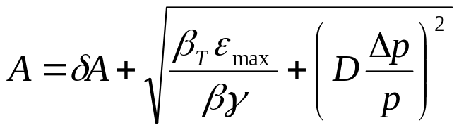
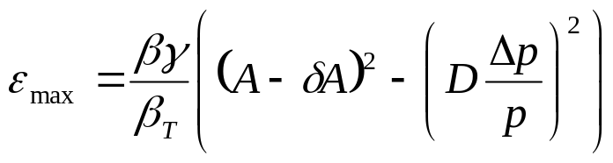
Evaluate Effect of Improvements
Calculate effect of various improvments based on increased acceptance (a la McGinnis):
Use:
Effective aperture
reduction
Condition | Date | δA | max D | max beta | Acceptance | Relative
 | Completed | (mm) | (m) | (m) | (π-mm-mr) | Increase (%)
Start of MiniBooNE | --- | 10 | 6.2 | 45.8 | 15.7 | -15
Dogleg 3 Fix | Oct-03 | 10 | 4.5 | 40.8 | 18.4 | 0
Dogleg 13 Fix | Oct-04 | 10 | 3.8 | 36.1 | 21.0 | 14
Alignment | Oct-05 | 8 | 3.8 | 36.1 | 24.3 | 32
ORBUMP | Oct-05 | 5 | 3.8 | 36.1 | 29.5 | 60
correctors | Oct-06 | 2 | 3.8 | 36.1 | 35.2 | 92
Ideal | --- | 0 | 3.19 | 33.7 | 42.3 | 130

Slide 13
Effect on Max Proton Intensity
Prior to this shutdown, regularly delivering 7.5E16pph with ~40% reduction in activation around most of the Booster.
  Assume after another year of tuning and collimator optimization, we could have hit 1E17 pph with no other improvments (“fallback” = .9E17).
Operational experience: tuning asymptotically approaches benefit of a particular improvement:
  Assume after one year of tuning, 50% of the benefit of a particular improvement is realized (fallback = 25%).
Date | “Design” Limit (1E16 p/hr) | Fallback Limit (1E16 p/hr) | Comment
1/2006 | 10.7 | 9.3 | Effect of collimators, dogleg fix, plus some alignment
1/2007 | 13.0 | 10.4 | Alignment and ORBUMP
1/2008 | 14.6 | 11.0 | New corrector system

Slide 14
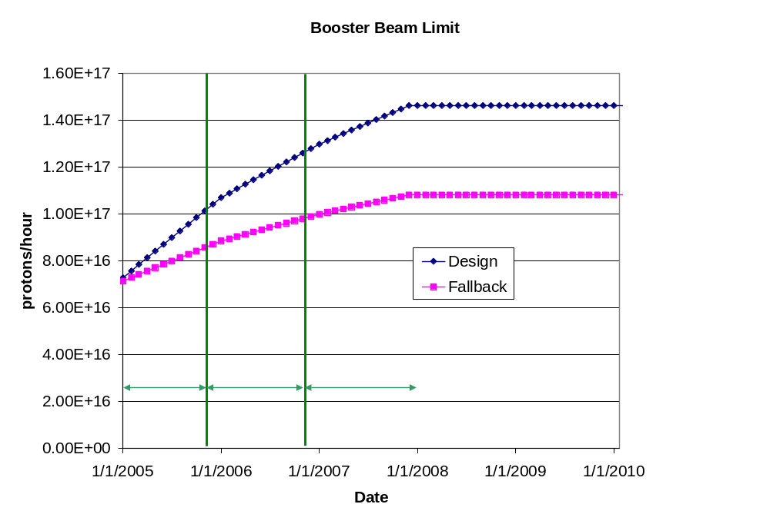
Predicted Proton Intensity Limits

Slide 15
Calculating NuMI PoT
Even the fallback scenario accommodates NuMI operation.
Assume the following
  Ramp up to full 5*5E12 batch operation by April 2005
  Ramp up to full 9*5.5E12 batch slipstacked operation a few months after MI RF upgrade.
  90% efficiency during slip stacking.
  10 month operation each year.
  81% total uptime for remainder of years (based on MiniBooNE. Includes scheduled and unscheduled downtime).
  85% avg/peak operating efficiency (negotiable).
Will add:
  Extra downtime for shot setup and fast transfers (~10%).

Slide 16
Calculating MiniBooNE PoT
Trickier:
  Still limited by beam loss, NOT rep. rate.
  Assume antiproton and NuMI have priority, so
  MB VERY sensitive to proton limit and its fluctuations.
Use:
(avg pph) = (pph lim.)*η – (NuMI pph) – (pbar pph)
Also assume:
  10 month operation
  81% up time (based on 2004)
Will add:
  Increased protons during shot setup.
Avg/pk ~ 86%

Slide 17
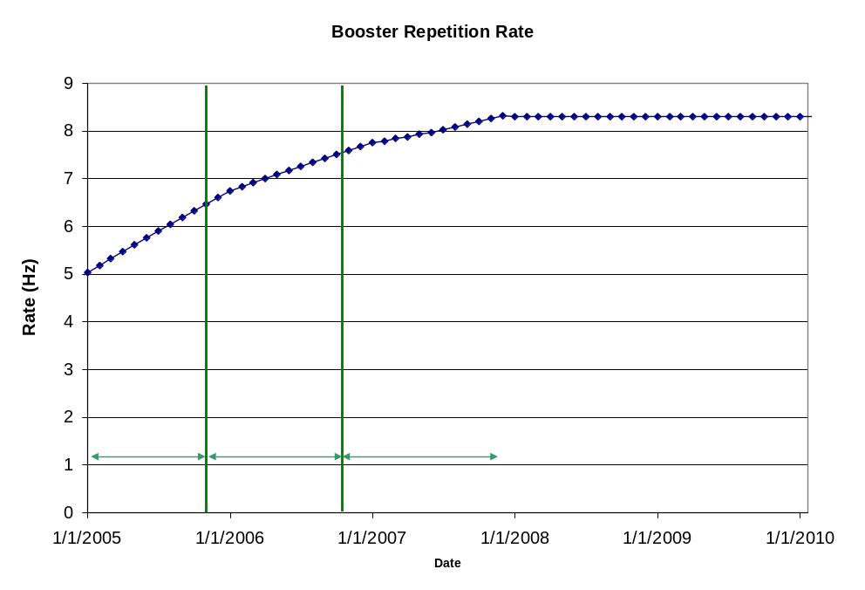
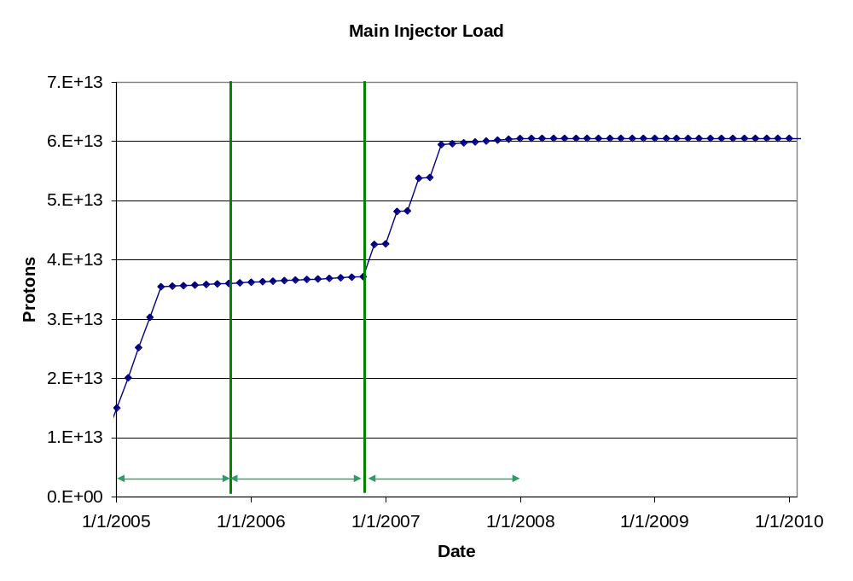
Machine Loading

Slide 18
“Design” PoT
Phase | Booster Batch Size | Main Injector Load | Cycle Time | MI Intensity | Booster Rate* | Total Proton Rate | Annual Rate at end of Phase
 |  | (AP + NuMI) | (sec) | (protons) | (Hz) | (p/hr) | NuMI | Mini-BooNE
July, 04 | 5.0E+12 | 1+0 | 2.0 | 0.5E+13 | 5.7 | 0.8E+17 | 0 | 3.9E+20
I | 5.10E+12 | 2+1→2+5 | 2.0 | 3.6E+13 | 6.3 | 1.0E+17 | 2.4E+20 | 1.2E+20
II | 5.3E+12 | 2+5 | 2.0 | 3.7E+13 | 7.5 | 1.2E+17 | 2.4E+20 | 2.4E+20
III | 5.50E+12 † | 2+9 | 2.2 | 6.1E+13 | 8.3 | 1.5E+17 | 3.7E+20 | 1.6E+20
11 Hz (beyond plan) | 5.50E+12 | 2+9 | 2.2 | 6.1E+13 | 11.0 | 2.0E+17 | 3.7E+20 | 4.4E+20

Slide 19
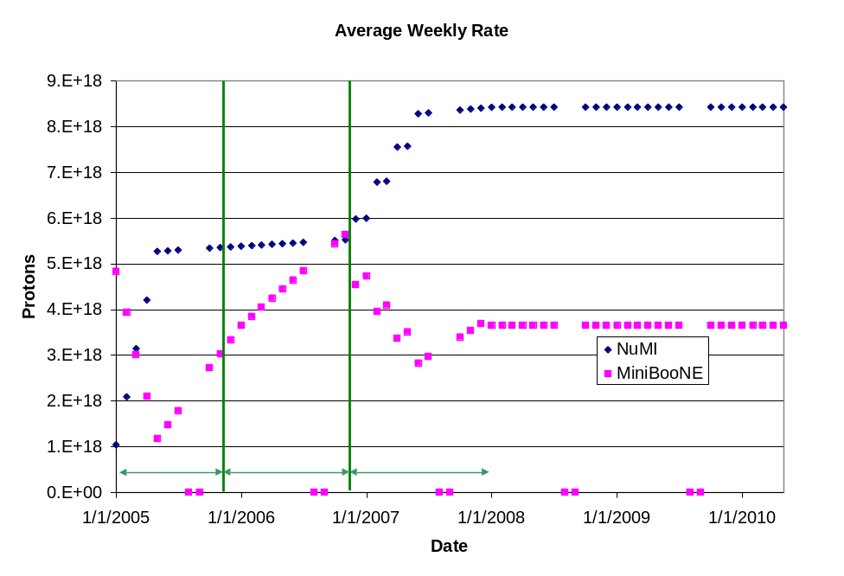
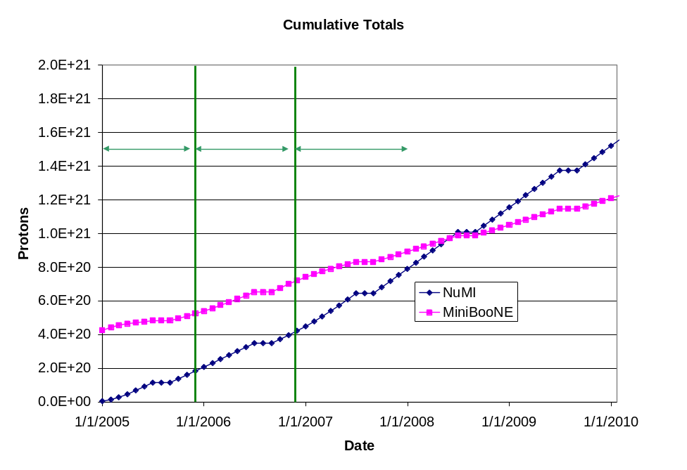
“Design” Totals

Slide 20
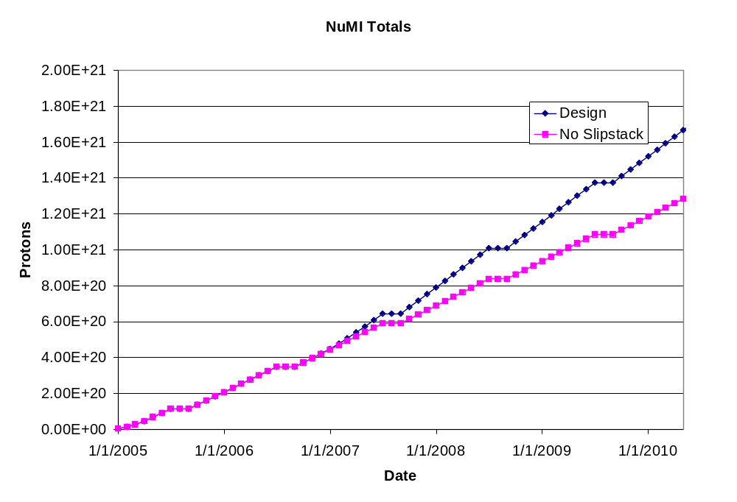
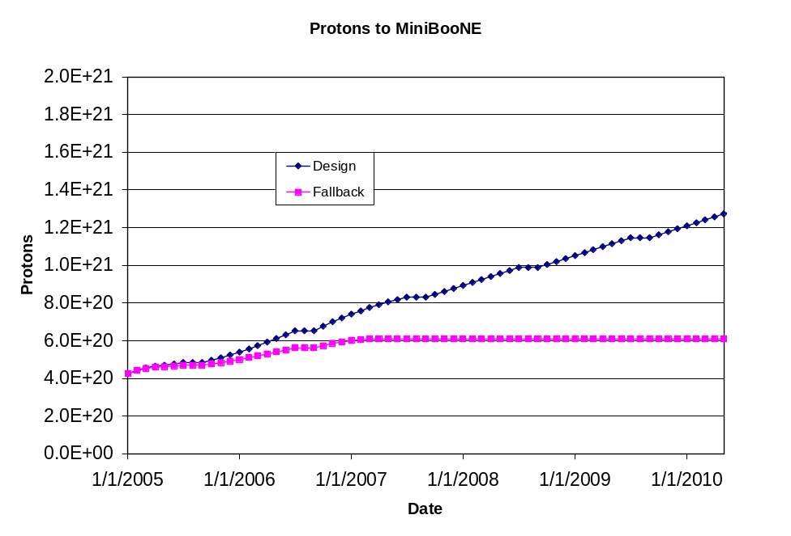
“Fallback” Totals

